Slide 1

Pre Operative Investigations
ECG & ECHO
Dr.G.K.Kumar,MD,DA,FIPP,DHSc,
Pain Physician & Interventional Pain Specialist,
Indian Institute Of Pain Management, Chennai,
Professor Of Anaesthesiology,
Govt. Chengalpattu Medical College Hospital,
President, Indian Society for the Study of Pain, TN Chapter.

Slide 2

Pre Operative Investigations
ECG & ECHO
What To Look For Preop ECG?
Interpretation Of Echo
– Which Numbers Matter?
What Do They Mean?

Slide 3


Perioperative care modification
Reduction of morbidity & mortality
Preoperative Evaluation
Risk Stratification
Patient & Surgical factors
Management of perioperative period
Management of MACE [Major Adverse Cardiac Event]

Slide 4


Objectives
Pre Anesthesia ECG
Pre Anesthesia ECHO
What can we acquire?

Slide 5
EcG

Slide 6
Pre Anesthesia ECG
Indicated
H/O
CAD, hypertension, diabetes, congestive heart failure
Chest pain, palpitations
Cardiac murmurs
Peripheral edema, syncope, dizziness, dyspnea on exertion, orthopnea, paroxysmal nocturnal dyspnea
Cerebrovascular disease

Slide 7
Pre Op ECG
HT
LVH
Strain Pattern
Left axis deviation
LBBB
Should be evaluated for CAD.

Slide 8
Pre Op ECG
CAD
Q waves
RBBB
LBBB

Slide 9
Pre Op ECG
Hypertrophic CM
LVH
ST-segment and T-wave abnormalities
In Non HT with murmur increased with Valsalva

Slide 10
Pre Op ECG
Digoxin Toxicity
Paroxysmal atrial tachycardia with a 2:1 atrioventricular (AV) block is pathognomonic of digoxin toxicity
Junctional tachycardia
Ventricular ectopic beats
Bigeminy
Second-degree AV block
Electrolyte disorders
Pace Makers

Slide 11
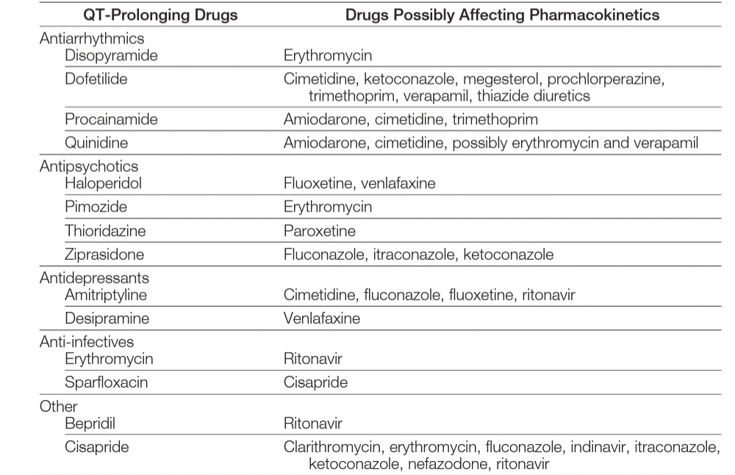

Pre Op ECG
QTc interval
Males : 360-390 msec
Females: 370-400 msec
>450 > 460

Slide 12
ECHO

Slide 13


Slide 14
Disclaimer
I Am Not An Anti Indian

Slide 15
Pre Anesthesia Echo Helps Us
LV Function - Systolic / Diastolic
Valves Morphology - Aortic/Mitral
Regional Wall Motion Abnormality
Intra Cardiac Pressure Measurement
Prosthetic Valves
Stress Echocardiography

Slide 16
LV Systolic Dysfunction
Commoner , more worse
CAD
MI
DCM
LV Diastolic Dysfunction
HT
HCM
RCM
DM

Slide 17
LV Systolic Function Assessment
EF - Ejection Fraction
GLS - Global Longitudinal Strain measurement
MAPSE / TAPSE - (Mitral / Tricuspid Annular Plane Systolic Excursion)
Chamber Hypertrophy
Fractional Shortening

Slide 18
LV Systolic Function Assessment
EF - Ejection Fraction
> 50% - Normal
50 -30 - Moderate
<30 - Severe
Severely decreased (<30%) EF) itself is an independent prognostic factor for MACE in patients with HF
Survival after surgery for those with a LVEF ≤29% is significantly worse
The risk of death did not increase notably until LVEF fell below 40%
50-40-30

Slide 19
LV Systolic Function Assessment
GLS – Global Longitudinal Strain
-18-20 - Normal
< - 15 - Significant
GLS more reliable in regurgitate valves
Early dysfuction
-20-15

Slide 20
LV Systolic Function Assessment
MAPSE – Mitral Annular Plane Systolic Excursion
12 to 15 mm – Normal
< 8 - Significant
TAPSE – Tricuspid Annular Plane Systolic Excursion for RV Function
15 to 25 mm - Normal
< 10 - Significant
MAPSE a sensitive early marker of LV systolic dysfunction in HT with normal EF
<8 mm was associated with a depressed LV EF (<50%)
15-8

Slide 21
LV Systolic Function Assessment
FS - Fractional Shortening
25–45% Normal
20–25% Mild
15–20% Moderate
<15% severe
Fractional shortening (FS) is widely used to assess LV dysfunction
Calculated EF – FS x 2
15

Slide 22
LV Systolic Function Assessment
Chamber Hypertrophy
10mm-Normal LV thickness
>12mm – hypertrophied
<5 mm – thinning /scar
12,5

Slide 23
LV Diastolic Function Assessment
Normal LV Systolic Function
Mitral EA Ratio
Tissue Doppler (TDI) of the mitral annulus
E/e´ ratio

Slide 24

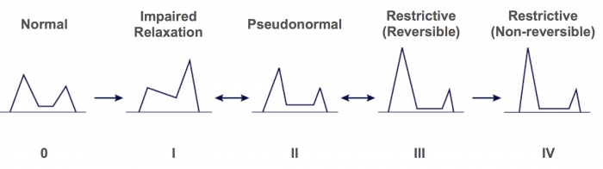

LV Diastolic Function Assessment
Mitral EA Ratio
≤ 0.8 & > 2 – normal
Normal pattern of diastolic filling: the E-wave is taller than the A-wave
>2

Slide 25
LV Diastolic Function Assessment
Tissue Doppler (TDI) of the mitral annulus
< 10 – normal
>10 indicates increased LAP
>10

Slide 26
LV Diastolic Function Assessment
E/e´ ratio
< 8 – Normal
>14 – dystolic dysfunction
Limitations in LVS dysfunction
>14

Slide 27
Regional wall motion abnormality
Indicates Ischemia / infarction
Hypokinesia
Dyskinesia
Akinesia
Aneurysmal dilatation
LV wall thickness 10 mm
>12- <5

Slide 28
Valves Morphology
Valve Surface Area
Jet / Peak Velocity
Pressure Gradient

Slide 29
Valves Morphology
Valve Surface Area
MVA & AVA
>4 CM² - Normal
1.5 - 1CM² - Moderate Stenosis
< 1 CM² - Severe Stenosis
MVA & AVA
4 – 1.5 -1.0

Slide 30
Valves Morphology
Jet/Peak Velocity
Mitral
1.5 m/s - Normal
>2 - Stenosis
Aortic
1-1.8 m/s - Normal
>4m/s – Severe AS
MV Jet Velocity 1.5 – 2
AV Jet Velocity 1.8 – 4

Slide 31
Valves Morphology
Pressure Gradient - Not a best marker
MV-PG
2-4mmHg -Normal
<5 - mild
5–10 - moderate
>10 - severe
AV-PG
10-20mmHg -Normal
<20 - mild
20–40 - moderate
>40 - severe
MV PG >10
AV PG > 40
Notes:
pressure gradient is not the best marker of MS severity as it is affected by heart rate, cardiac output and associated mitral incompetence. Nonetheless, it has its own prognostic value, particularly following balloon mitral valvuloplasty, and it may have a special benefit in case of poor quality of other variables (especially planimetry of valve area)

Slide 32
Intra Cardiac Pressure Measurement
LAP
10-15mmHg normal
>25 associated with PHT
PAP
25-30 mm Hg– Normal
35-45 – mild
45-60 – moderate
>60 - Severe
LAP-15- 25
PAP-30- 60

Slide 33
Other Measurement
Stroke Volume
Based on aortic cross section & velocity
IVC Diameter
Volume Status Vs Congestive Status
Stress Echo
Angina with Normal Echo
Transplant Recipients

Slide 34

To Conclude
TTE is one non-invasive test that is commonly requested to provide additional prognostic information.
Assessment of preload and myocardial contractility is an essential accompaniment to the successful modern management of the high risk surgical patient.
It is as yet equivocal whether adding echocardiography values to models of risk prediction improves their predictive strength.
Understanding of the Echocardiographic values helps to stratify, modify,& manage MACE

Slide 35
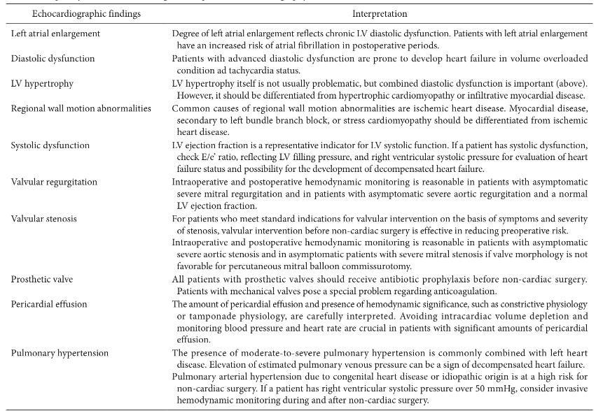

Slide 36
Thank You
Dr.G.K.Kumar

Slide 37






Dr.G.K.Kumar,MD,DA,FIPP.,
Indian Institute of Pain Management
painclinicchennai@gmail.com
chennaipainclinic@facebook.com
chnpainclinic@twitter.com
9003275457
www.painclinicchennai.com

Slide 38

Let’s make a pain free world…

Slide 39
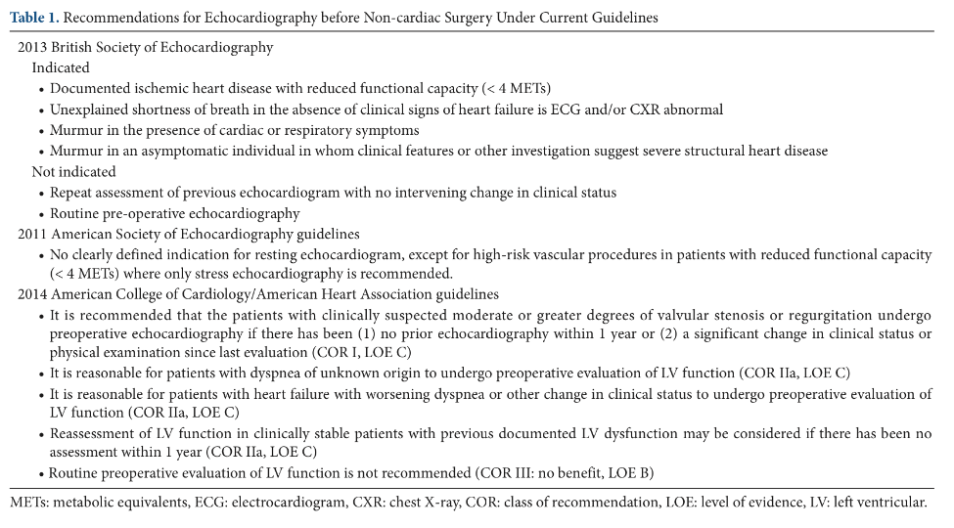

Slide 40
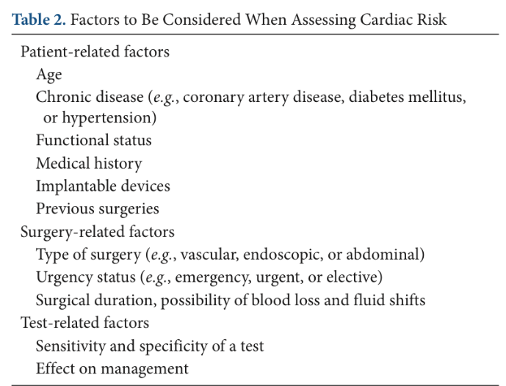

Slide 41
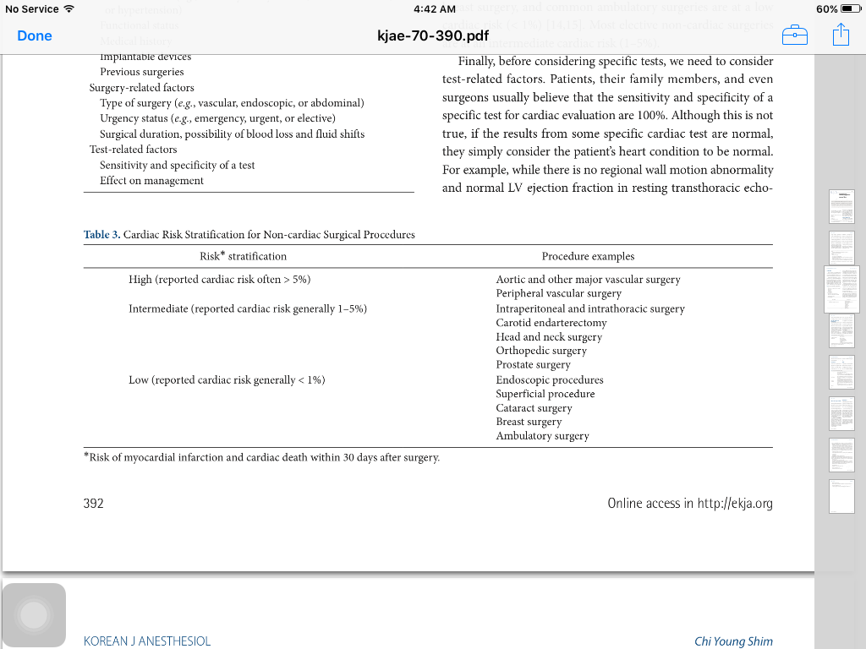

Slide 42
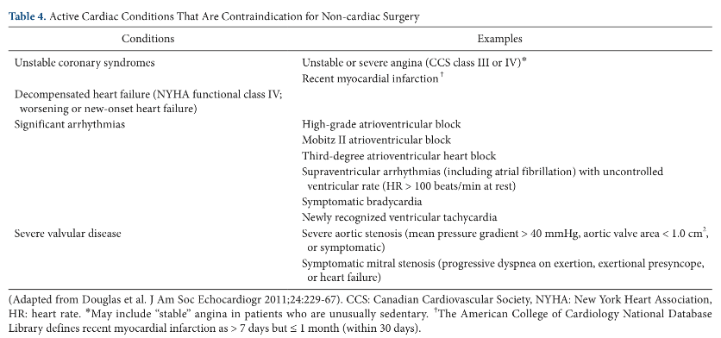

Slide 43
Pre op echo
Impact on pre-operative management
Transthoracic echocardiography can be used anytime in the period preceding surgery, from the pre-assessment clinic to the anaesthetic room.
shown to influence anaesthetic management
Resting pre-operative
TTE is one non-invasive test that is commonly requested to provide additional prognostic information.
It is as yet equivocal whether adding echocardiography values to models of risk prediction improves their predictive strength.
This may be either because resting TTE cannot reliably detect coronary artery disease and inducible ischaemia, or because there are limited therapeutic options for poor systolic function.
Barber and Fletcher | Impact of echocardiography, Anaesthesia 2014, 69, 764–776

Slide 44
Pre op echo
It is important to note that left ventricular dysfunction is not purely confined to systolic function.
Half of patients with congestive cardiac failure have normal systolic function
Diastolic dysfunction is an independent predictor of adverse outcome after major vascular surgery and can be assessed using TTE
The incorporation of pulse wave and tissue Doppler into modern bedside ultrasound
Right ventricular dysfunction in cardiac surgery significantly increases the resulting morbidity and mortality. Severe pulmonary hypertension is associated
with a 7% mortality rate in non-cardiac surgery in which right ventricular failure was a contributing cause of death [37]. Recognition of the condition
Echocardiography is the only practical investigation available for confirmation of the diagnosis of right ventricular failure, and is accurate for the evaluation of pulmonary hypertension
Barber and Fletcher | Impact of echocardiography,Anaesthesia 2014, 69, 764–776

Slide 45
Pre op echo
Echocardiography is surely a powerful tool when in the hands of the person posing the clinical question, who is then in the position of translating the results of the scan into a peri-operative plan.
Echocardiography has been shown to change the cardiac diagnosis in as many as 67% of emergency surgical patients.
Three of the four patients with a clinical diagnosis of cardiac failure made by the anaesthetist were revealed to be incorrect. Two of these patients were found to be hypovolaemic on TTE and administration of fluid boluses was required. Similarly, three of the five patients assessed as hypovolaemic by the anaesthetist had cardiac failure,
The validity of left ventricular assessment with resting TTE to reduce individual mortality and morbidity?
Assessment of preload and myocardial contractility is an essential accompaniment to the successful modern management of the highrisk surgical patient.
Barber and Fletcher | Impact of echocardiography,Anaesthesia 2014, 69, 764–776

Slide 46
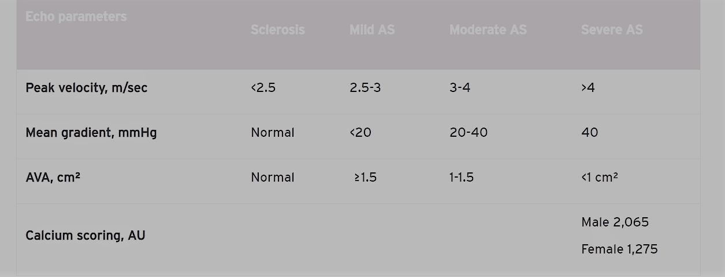
Valves Morphology

